Slide 1
RCOTSS-Housing Membership Survey Summary 2019
Aim
To identify how members engage with services/events provided by RCOTSS-Housing
To receive feedback on how RCOTSS-Housing communicates with it’s members
To identify which member benefits are most valued by the membership
To shape and improve services better for members going forward
Sent to all current members as at end of May 2019
57 completed questionnaires received which equates to 19% of membership

Slide 2
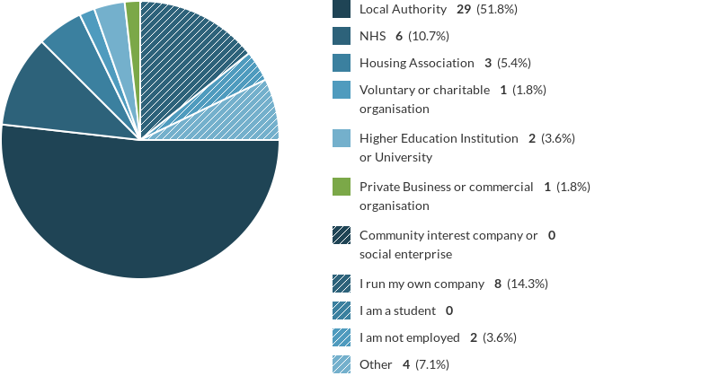
Who Are Our Members?

Slide 3
Do You Have Clinical Interests In Other Areas?
44.4% said yes
Areas include:
Older people (x4),
Adult Social Care/Community (x5)
Moving & Handling (x2)
Orthopaedics (x2)
Hand injuries (x1)
Personalised care – social prescribing (x1)
Preventative (x2)
Postural seating (x1)
Independent practice (x3)
Medico-legal (x1)
Pain management (x1)
Telecare (x1)
Paediatrics (x4)
Progressive neurological conditions (x3)
Ergonomics (x1)
Work (x1)
Rehabilitation Networks (x1)
Hoarding (x1)
Third sector networks (x1)
Independent Living networks (x1)
Brain Injury (x1)
Learning Disability (x1)
Education (x2)

Slide 4
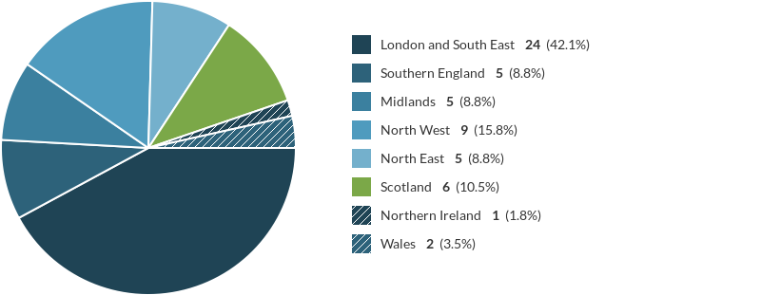
Which Region Do You Belong To?

Slide 5
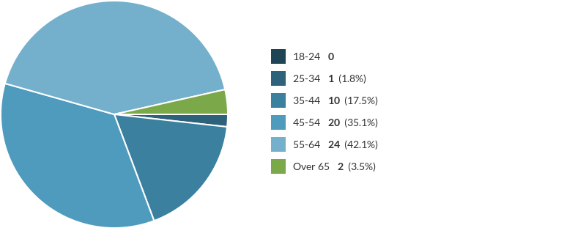
Age Demographic Of Respondents

Slide 6
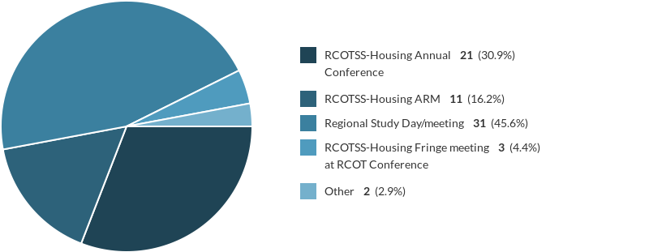
Have You Attended Any RCOTSS-Housing Events In The Last 2 Years?

Slide 7
Attendance At RCOTSS-Housing Events
40 out of 57 respondents have attended an RCOTSS-Housing event 70% of total respondents
45.6% have attended a regional study day in the last two years
30.9%have attended conference in the last two years
Reason for not attending:
Location 40%
Unable to get leave 17.8%
Other – time, housing conference more relevant, retired, illness, date not suitable
Cost 20%

Slide 8
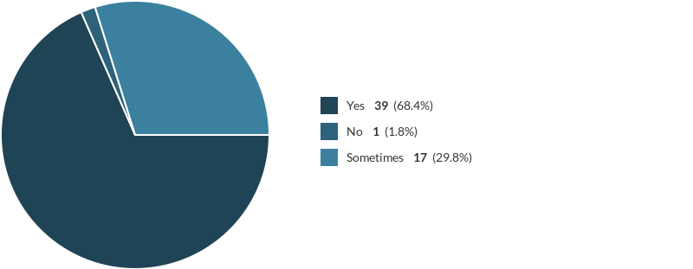
Is RCOTSS-Housing Helping To Meet Your CPD Needs?

Slide 9
What Events Would Members Like RCOTSS-Housing To Organize/Run
33 Responses from 7 of 8 regions
London & SE Region
Opportunity to consider specific adaptations in relation to clients
Housing design courses
Basic research in work place
Workshop to evidence practice
Legal challenges and complaints resolution case discussion
Outcome measures
Ramping
Promoting OT & Housing adaptation needs
More time for case discussion
Southern Region
Webinars or similar
More regional meetings
Local study days
Examples of sustainable housing initiatives
Wales
Events in South Wales
Local Home adaptations training

Slide 10
What Events Would Members Like RCOTSS-Housing To Organize/Run
North West Region
More Regional study days
Paediatric focused study days
Midlands Region
More Local events
More local events with regional meeting or university
More across full area of region
Scotland
More adaptation specific training (ramps/showers)
Online CPD
More locations
NHS related study days
Northern Ireland
Home environmental controls

Slide 11
What Events Would Members Like RCOTSS-Housing To Organise/Run?
Positive responses – London & SE Region
What is on offer for London and South East is great and we are lucky to have a large active and enthusiastic group
Happy with current study days & Conference
I think all your events are great & newsletters very informative
I think current activity is balanced and meets needs of members
Positive responses – North West Region
Continue with great study days
I like conference when I can get there

Slide 12
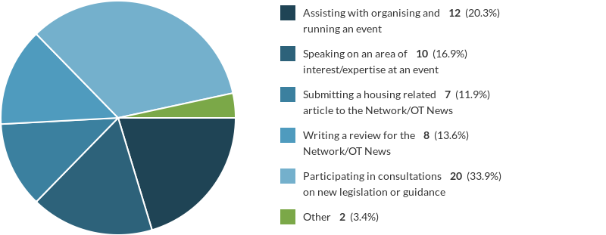
Would You Be Able To Help?

Slide 13
Elma Shearer Award Do You Think This Should Continue?

Slide 14
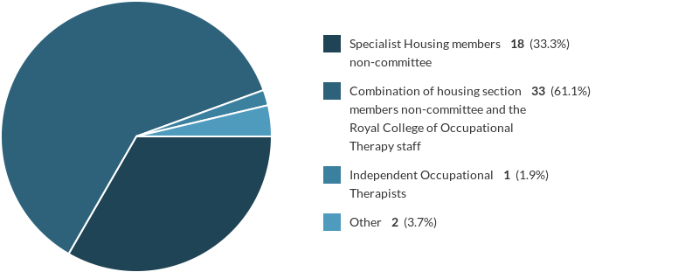
Who Should Judge The Elma Shearer Award?

Slide 15
Network Bulletin
100% read the bulletin
80.7% feel it is well presented
98.2% feel it is relevant and informative
89.3% feel it enables them to keep in touch with new developments nationally and locally
85.9% feel it enables them to share good practice and advice from other professionals

Slide 16
RCOTSS-Housing Pages On RCOT Website
60.7% had accessed these pages
Of those who had, 37.8% found them easy to locate and navigate around
67.6% found them relevant and informative

Slide 17
Would You Access Or Contribute To An RCOTSS- Housing Clinical Forum?
64.8% would access or contribute to a clinical forum
Reasons include:
To post questions, topic discussion,
To share knowledge
Seeking expert knowledge,
For practice queries
Peer advice & information
To research,
To develop area of practice and service

Slide 18
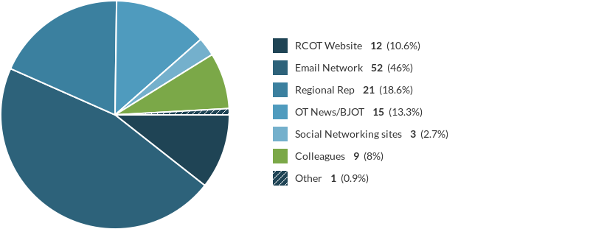
Communication – How Do You Find Out About RCOTSS-Housing Events?

Slide 19
Communication
55.4% said they would be interested in using social media such as Facebook or Twitter
53.8% said they would contribute via Social media
42.1% have contacted their regional rep in the last year with 96% satisfied with the response
65.5% receive regular contact from their regional rep with information 90% about right
44.6% have accessed the handbook
54.5% were satisfied with the handbook
52.6% know they can contribute to consultations

Slide 20
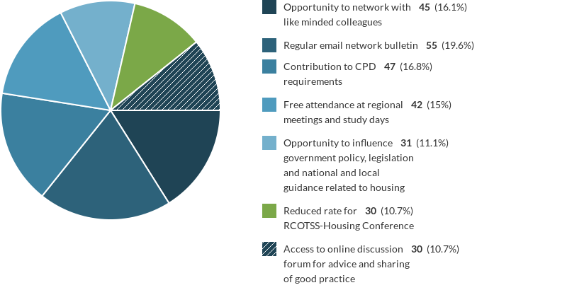
Which Member Benefits Do You Find Valuable?

Slide 21
How Should RCOTSS-Housing Promote The Profession?
London & SE Region
Joint working with Foundations
Impact of housing outside of statutory provision
New house development & purchase of accessible homes
Articles in OT News
Research & Evidence of Housing adaptations & cost savings for NHS/ASC & positive benefit to client
Evidence value of OT using formal evaluation & case studies
Broader public profile
Lobbying policy makers
London & SE Region
Speaking at Housing Conferences
Better promotion of DFG & value of OT
Encouraging self funders to seek assessment
Consulting at Govt & National Level
Examples of good practice for councils
Interacting with other professionals
Midlands Region
More on Social Media

Slide 22
How Should RCOTSS-Housing Promote The Profession?
North West Region
Attendance at Non OT Housing Conferences
Networking with Housing, Independent Sector, Equipment services and Universities
Northern Ireland
Joint events with Housing/Social Services/Disabled people
Scotland
Written Information to use with housing colleagues
Relevant for retired members
National publicity – making adaptations more attractive
Social networking
North East Region
Constructive links with leader in local councils at strategic and service level
Southern Region
National level via RCOT
OT’s in housing undervalued and not fully understood as to what they can contribute
Wales
Promoting value of OT’s in Housing

Slide 23
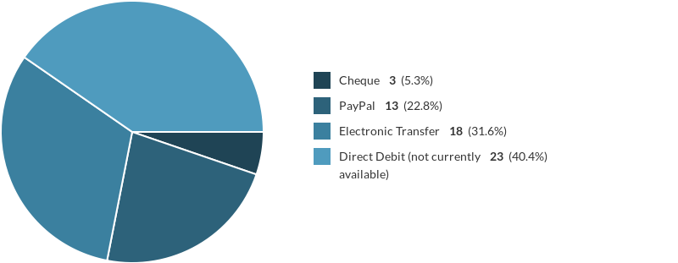
Membership – Which Method Of Payment Would You Prefer For Membership Subscription?
96.4% would be interested in renewing membership on line

Slide 24
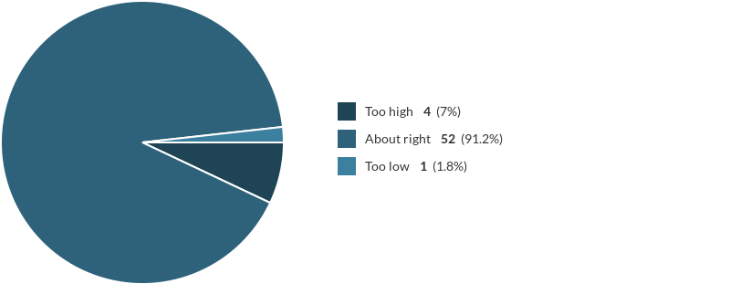
Cost Of Membership

Slide 25
How Else Can We Improve RCOTSS-Housing For Members
London & SE Region
More accessible information for non statutory provision
Smaller sub groups that could meet informally on a regular basis
A few webinars
Training OT students on the role & skills required
North East Region
Haven’t had any study days for years, networking & communication in our region not well established or effective
North West Region
Alternate days of week for study days in North West
Southern Region
More opportunities for online activities, ability to leave comments/share ideas ?Facebook or similar
Haven’t had any local study days for years, have previously arranged and participated in them
Midlands Region
More in-depth feature about housing aspects
Keep information easily accessible
Include info for researchers in housing

Slide 26
How Else Can We Improve RCOTSS-Housing For Members
Northern Ireland
Higher RCOT fee with complimentary specialist section membership
More advertisement for new members and the benefits this brings. Wider study days for all member across the UK/ Larger region areas. More links with accessible design networks such as architectural design, to influence sustainable housing
Scotland
Keep up good work
Ensure all content is labelled with the region(s) it applies to or is relevant to. England is one region and should not be regarded as the default just because it is largest. Things are better than they used to be but there is still room for improvement. I can still read things and sometimes not be clear whether it applies to me in Scotland or not.How many retired members are there?
Wales
Publicise regional meetings
Regular Network Edition emails

Slide 27
Next Steps
Detailed analysis of survey responses to inform action plan
Regional rep role crucial – consider how to recruit where we presently have no rep
Look at alternatives for providing local study days for areas struggling to arrange these or with no rep
Keep up the good work!
“The work of the team is above their day job and much appreciated to put on 2 study days and support the annual conference. Celebrate those who put this work in. Thanks so much” (London & SE Member)

